Slide 1





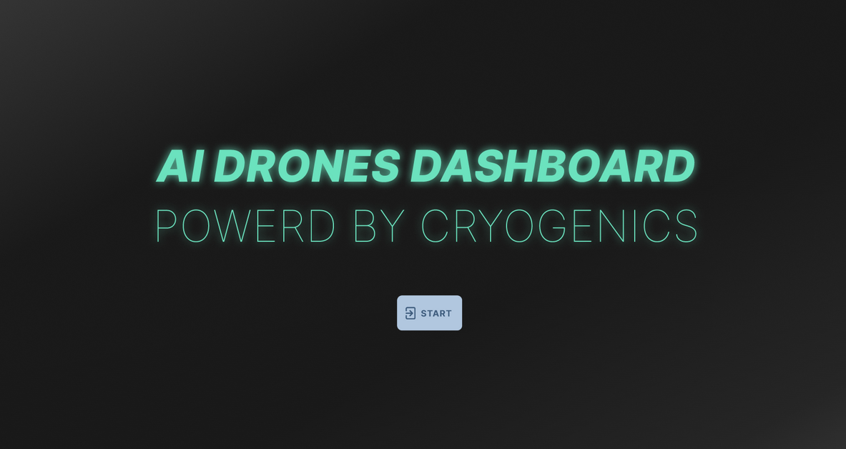

NASA Space apps challenge 2023
MANAGING FIRE:
INCREASING COMMUNITY BASED FIRE MANAGEMENT OPPURTUNITIES
Presented by: Team Cryogenics

Slide 2
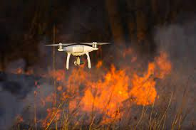

Problem Statement
Managing Fire: Increasing Community-based Fire Management Opportunities
However, as wildfires continue to increase in frequency, number, and size, the need for more diverse stakeholder groups to understand and use these data is rapidly expanding.
Wildfires can have many negative impacts including a loss of biodiversity, poor air quality, increased soil erosion and landslides

Slide 3





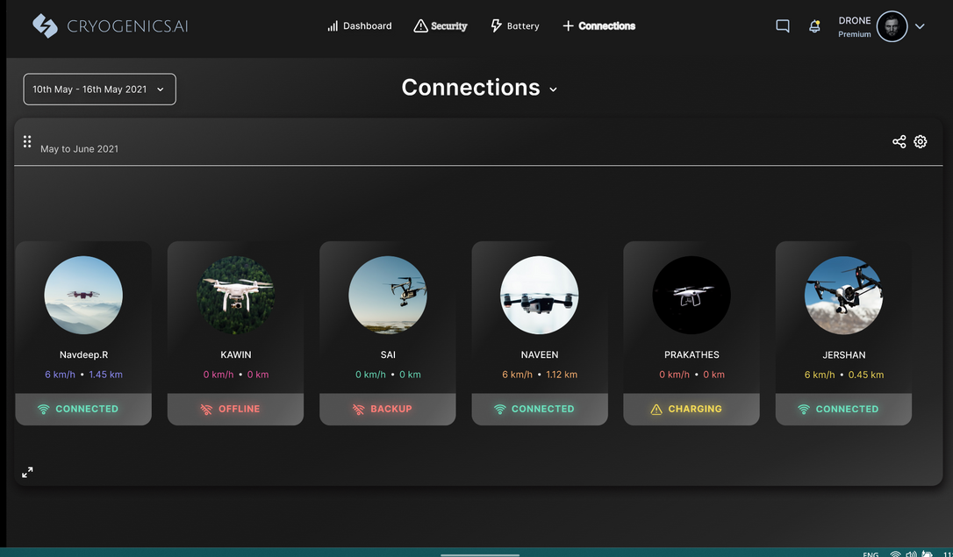
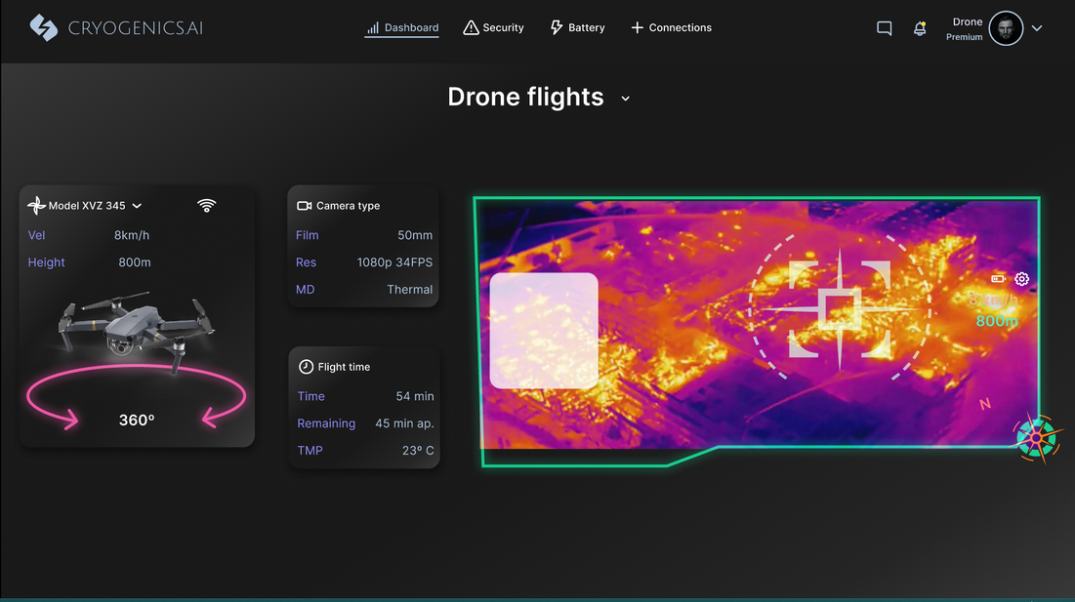

What is our solution?
01
02
03
04
Autonomous charging system for drones
Four power stations and Four main drones and four backup drones
Initially drones are in surveillance mode and after detecting fire it enters into track mode
A drone based software is developed for surveillance

Slide 4



IDEATE
IDEA
Idea is to create a deep learning model to analyze infrared thermal images. This model is then incorporated in the drones through which forest fire monitoring is done
INNOVATION
Autonomous flight drones with automatic charging module using deep learning to detect the fire in forest

Slide 5






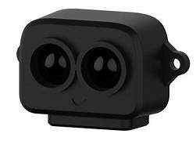
Concepts / Technology used
-FRONT END
-CSS
-HTML
-Figma
-BACK END
-TensorRT
-OpenCv
-PID controller
-CNN Model
_python
-HARDWARE
-Jetson nano 4G
-TF Luna
-Thermal camera

Slide 6




Future scope
Response
We are going to increase the response time of the drone
Execution
Give the access for local users
Analysis
Carrying sodium azide and sodium bicarbonate to use it as a alternate source for controlling forest fire

Slide 7
REFERENCES
Problem statement: https://www.spaceappschallenge.org/2023/challenges/managing-fire-increasing-community-based-fire-management-opportunities/
Slide 2 Picture citation: https://www.paperdesk.in/robot-drones-help-detect-and-prevent-ever-increasing-forest-fires/
Slide 3 Picture: Using figma our team created an app
Slide 4 Ideate: https://spectrum.ieee.org/drones-sensors-wildfire-detection
Slide 5 logos: Respective companie’s logos

